Slide 1
DEVELOPMENT OF THE SKELETON
Dr. Mbira

Slide 2
During the 3rd week, as the neural tube is fusing, the mesoderm adjacent to it; paraxial mesoderm, differentiates into somitomeres in the head region and somites in the rest of the body.
These somites together with some cells from the neural crest and lateral plate mesoderm contribute towards the formation of the skeleton.
In the 4th week, the somites differentiate into sclerotome ventromedially and dermomyotome dorsolaterally.
By the end of th 4th week, sclerotome forms a loosely interwoven mass of cells called mesenchyme which then forms all the components of most of the skeleton whether fibrous tissue, bone or cartilage.

Slide 3
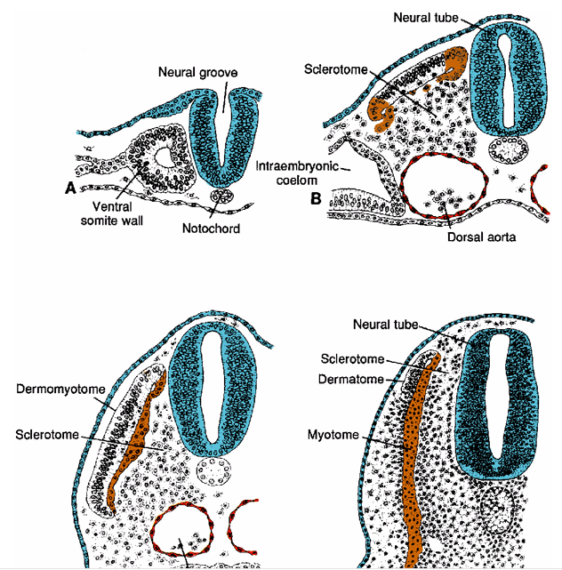

Slide 4
Neural crest cells in the head region forms mesenchyme that will form the bones of the cranium and facial bones.
Somites and somitomeres in the occipital region form the base of the skull as well as contributing to the rest of the skull.
Somatic layer of lateral plate mesoderm forms the limbs and the pelvic and shoulder girdles.
There are generally 2 types of ossification:
Membranous ossification – direct mesenchyme to bone formation
Endochondral ossification – mesenchyme to cartilage model then on to bone formation.

Slide 5
The cranium
Comprised of the neurocranium and viscerocranium.
The neurocranium is further divided into the bones of the vault(membranous part) and cartilaginous part(chondrocranium).
The membranous part of the neurocranium is formed by neural crest cells and somitomeres from paraxial mesoderm which form a sheet covering the brain and undergo membranous ossification to form flat bones that approximate each other to form the vault.
The base of the skull is formed from neural crest cells(anterior to sella turcica) and occipital somites forming sclerotomes(posterior to sella turcica), both of which form cartilaginous models that fuse together and undergo endochondral ossification.

Slide 6
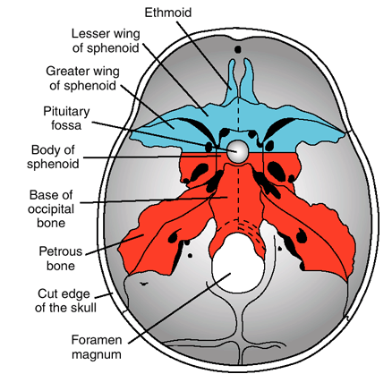

Slide 7
The viscerocranium(bones of the face) is formed mainly from the derivatives of the 1st and 2nd pharyngeal arches. The 1st arch has the following:
Maxillary process – maxilla, zygomatic arch, part of the temporal bone
Mandibular process – Meckel cartilage which in turn gives rise to the mandible and whose remnant persists as the sphenomandibular ligament.
The 2nd arch together with a tip from the mandibular process gives rise to the ossicles of the middle ear. They are the 1st bones to ossify, doing so in the 4th month.
The rest of the facial bones are derived from neural crest cells.

Slide 8
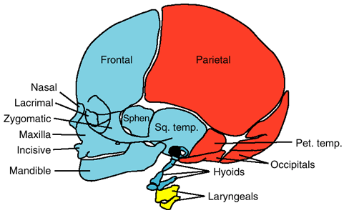
Red- somites and somitomeres
Blue- neural crest
Yellow- lateral plate mesoderm

Slide 9
The limbs
Develop from the end of the 4th week from the lateral plate mesoderm that forms a core of mesenchyme that will eventually form the skeleton of the limbs beginning as small protrusions called limb buds.
The limb buds are covered by a rim of thickened ectoderm called the Apical Ectodermal Ridge(AER).
AER causes the underlying mesenchyme not to differentiate but instead to keep growing and lengthening. Meanwhile, the part of the limb that is proximal and is now farther from the AER is now not influenced by it and begins to differentiate into the limb proper.
The upper limbs lie at the level of C3-T2 spinal segments while the lower limbs are at L2-S2.

Slide 10
By the 6th week, the terminal portion of the limbs flattens to form the hand and foot plates. Constrictions appear dividing the limb into 2 then the proximal portion is divided by another constriction into 2 again, thus the limb ends up with the 3 segments as seen in a fully formed limb, i.e thigh, leg, foot or arm, forearm and hand.
The AER undergoes apoptosis dividing it into 5 ridges which will later form the digits. They develop further by lengthening from influence from the rim of AER at the tip to define the digits better even as the webs in between undergo more apoptosis.
Mesenchyme in the limbs condenses to form rays of cartilage which will form the template for bone formation.

Slide 11
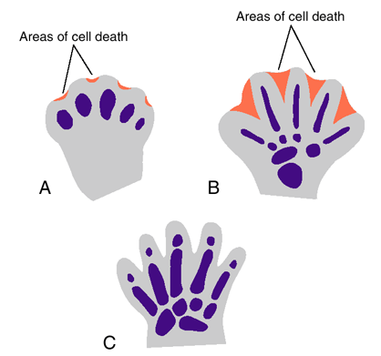

Slide 12
The lower limbs progress of development is usually 2 days behind that of the upper limb.
In the 7th week, the limbs rotate, in opposite direction. The upper limbs rotate laterally 90 degrees while the lower limbs rotate medially 90 degrees.

Slide 13
Joint formation
As the cartilage models for limb formation are forming in the 6th week, areas where a joint will form experience an arrest of cartilage formation with the result being a joint interzone.
Cells in the middle of the interzone undergo apoptosis forming a cavity(joint cavity) and the surrounding cells differentiate to form a joint capsule.
The end result is a cavity between 2 cartilage models that will become bone that is ensheathed/surrounded by a joint capsule and the inside edges of the cartilage model/bone are lined by hyaline cartilage as seen in the fully formed human.
If it is a fibrous joint, the interzone cells differentiate into fibrous tissue.
In the case of cartilaginous non-synovial joints, the interzone cells differentiate into fibrocartilage(pubic symphysis) or hyaline cartilage(ribs) depending on the joint.
This process is complete by the 8th week.

Slide 14
Bone formation/ossification
Can either be intramembranous or endochondral.
Intramembranous ossification occurs when the mesenchyme that is to form the bone forms a membranous sheath. Within this sheath, some mesenchymal cells differentiate to form osteoblasts which begin to secrete osteoid(unmineralized bone). Later calcium is deposited in this osteoid hardening it. The osteoblasts become trapped in this matrix and become osteocytes.
New bone is formed in layers/lamellae which are laid on each other. The centre of this bone is spiculated and remaining mesenchyme between these spicules becomes bone marrow.
Intramembranous ossification occurs in flat bones.
The 1st bone to undergo ossification in utero is the clavicle. Later it develops cartilage at its articular ends.

Slide 15
Endochondral ossification occurs mostly in the appendicular skeleton and other long bones.
A pre-existing cartilage model develops a primary ossification centre at its mid point from where ossification is started by osteoblasts brought there by invading blood vessels.
As the osteoblasts lay a matrix around them, calcium is deposited mineralizing and hardening it forming bone.
Some of the invading cells become cells of the bone marrow.
The ossification progresses towards the ends of the bone and chondrocytes undergo apoptosis as they are replaced by osteoblasts and osteocytes.

Slide 16
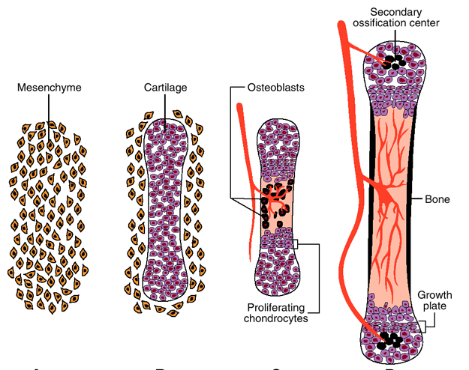

Slide 17
The ends of the bone still have a rim of cartilage from which new bone is formed as the bone grows and lengthens and this is the secondary ossification centre.
The initial ossification centre is in shaft of bone in an area called the diaphysis while the the secondary ossification centre at the cartilaginous ends of the bone are in a region called the epiphysis.
Between the 8th and 12th weeks, primary ossification centres have formed in bones that ossify endochondrally.
Secondary ossification centres only begin to form after birth except at the knee joint where it forms in the last month of pregnancy.

Slide 18
The epiphyses with the cartilage zone have a dermacation between the cartilaginous ends and the rest of the diaphyseal bone and these then form the zones of bone growth and lengthening during growth of the child.
Eventually once growth stops at the beginning of adulthood, the cartilage is replaced by bone and the epiphysis is fused to the diaphysis.

Slide 19
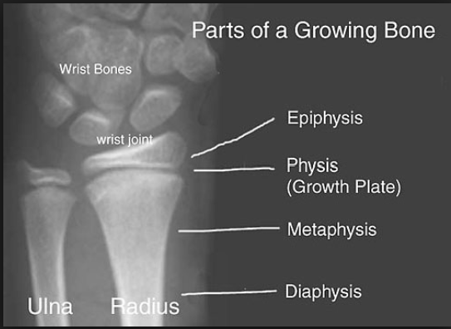

Slide 20
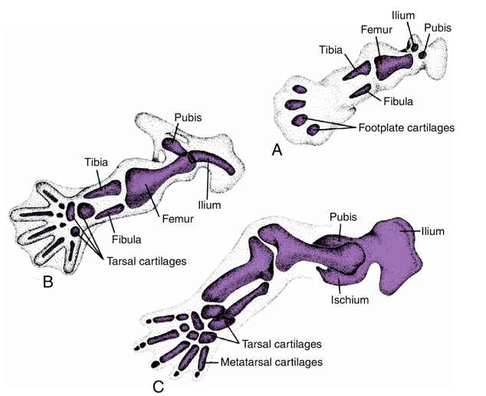

Slide 21
The vertebral column
Forms from around the 4th week when sclerotome cells from somites migrate around the neural tube to merge with cells from the other somite.
The fused sclerotomes then give half of their portion to the somite above and half to the one below so that the resulting vertebral bodies are made up of contribution from the somite above and the one below.
Homeobox genes are involved in the shaping of vertebrae in each vertebra segment.
The mesoderm in the intervening space between the half sclerotome that fuses upwards with its neighbour and the one that fuses downwards forms the intervertebral disc and the notochord disappears except in the middle of the intervertebral disc where it becomes the nucleus pulposus.

Slide 22
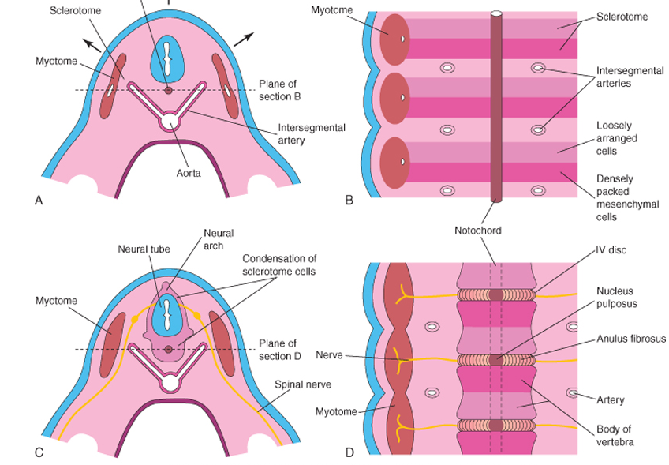

Slide 23
The ribs
Sclerotome in the thoracic segment of the vertebra develops into costal processes that grow outward and forward along the body wall and form cartilage models from whence ossification occurs, all in utero.
The sternum develops as a pair of bands of mesenchyme that develop in the body wall ventrally and later move towards the midline and fuse with each other.
These then develop a cartilage model for ossification of the sternum although ossification centre for the xiphoid only develops in childhood.

Slide 24
Achondroplasia
Polydactyly
Webbed hands and feet
Cranial synostosis
Chordoma
Phocomelia
Bone modelling and remodelling
Role of WNT in joint formation.
Role of SHH factor and HOX genes in limb development.

